Slide 1



Resume Classification using Machine Learning
Abhishek Suman(2115000037)
Govind(2115000416)
Dhruv Yadav(2115000369)
Guided by Assistant Professor Raushan Kumar Singh, Computer Engineering Department, GLA University.

Slide 2

Acknowledgement
Mentorship
Institutional Support
Thanks to Raushan Kumar Singh for guidance
Grateful to faculty of GLA University
Continuous Encouragement
Appreciation for ongoing support throughout project

Slide 3
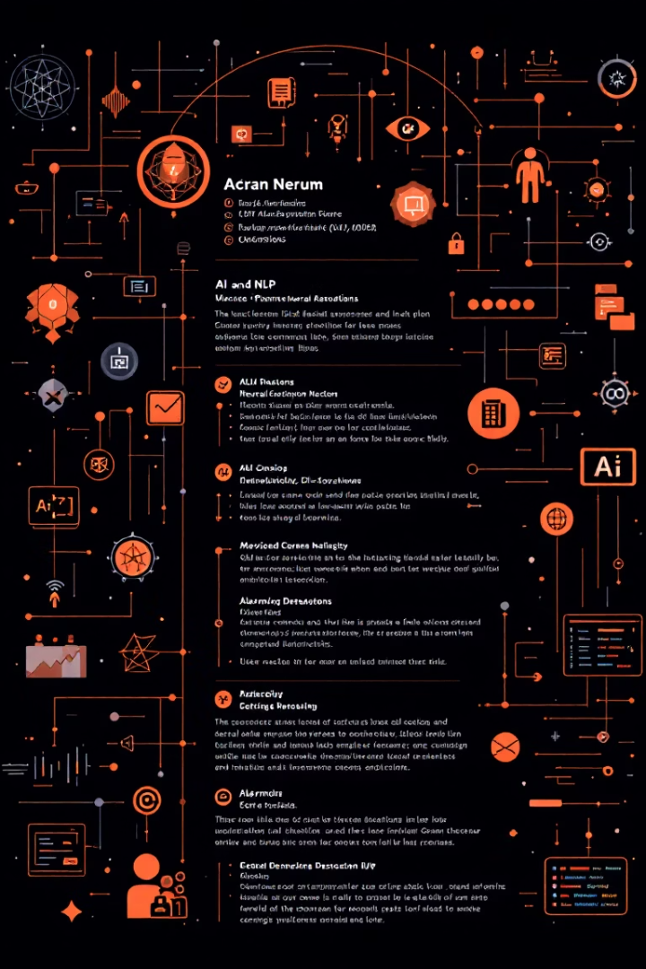


Abstract Overview
Automation Need
Resume screening is time-consuming
Technologies Used
NLP and Machine Learning for classification
Feature Extraction
TF-IDF effectively captures resume features
Results
SVM model achieving 98% accuracy

Slide 4




Outline of Presentation
Introduction
Software Requirement Analysis
Software Design

Slide 5

Introduction: Motivation
Labor-Intensive Screening
Automation Need
ML/NLP Advantages
Manual resume review is slow and error-prone
Automated tools reduce human bias and speed up process
Advanced matching through natural language processing

Slide 6





Introduction: Objective
Check Resume Relevance
Assist students in evaluating their resumes
Increase Selection Probability
Improve chances via optimized resumes
Smart Feedback
Provide instant, actionable resume suggestions

Slide 7




Introduction: Scope
2
Scalability
Supports multiple job roles and industries
Users
1
Students and placement cells
Improvement Suggestions
Personalized resume enhancement tips
3

Slide 8

Software Requirement Analysis
Language
Python
Libraries
Pandas, NumPy, Scikit-learn, Matplotlib, Seaborn
Tools
Jupyter Notebook, Google Colab
Operating Systems
Windows, Linux, macOS

Slide 9


Literature Review: Proposed Algorithms
CNN
Naive Bayes
Feature extraction via convolutional networks (Wang et al., 2017)
Keyword filtering enhanced Bayesian models (Bhatia & Sinha, 2019)
SVM with TF-IDF
BERT Embeddings
Effective text vectorization and classification (Kaur & Sharma, 2020)
Contextual representation improvement (Roy et al., 2021)

Slide 10



Key Challenges
Data Collection
Gathering diverse, quality resume datasets
Unstructured Data
Handling inconsistent formatting and layouts
Labeling Errors
Manual annotation inaccuracies affecting training
Preprocessing
Normalizing text, removing noise effectively
Model Accuracy
Ensuring relevance matching and generalization

